Slide 1

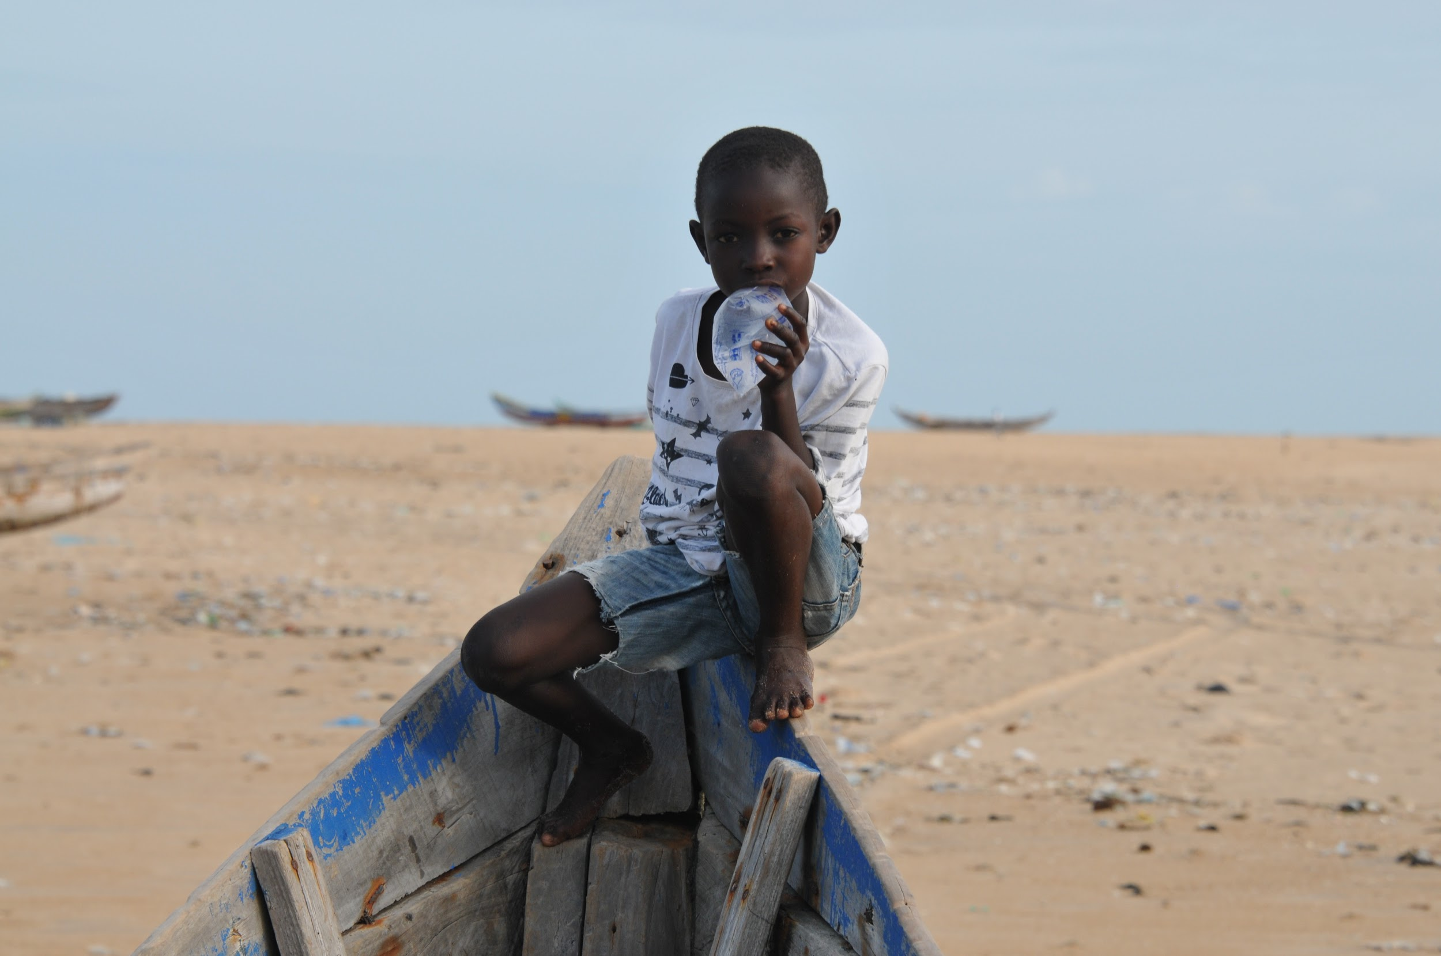
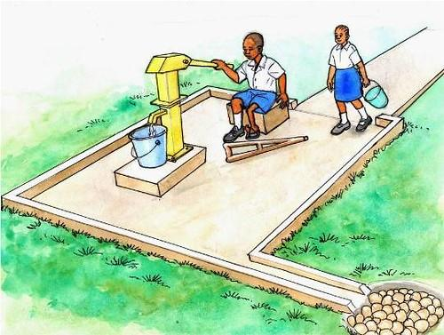
PSA
Access to water

Slide 2
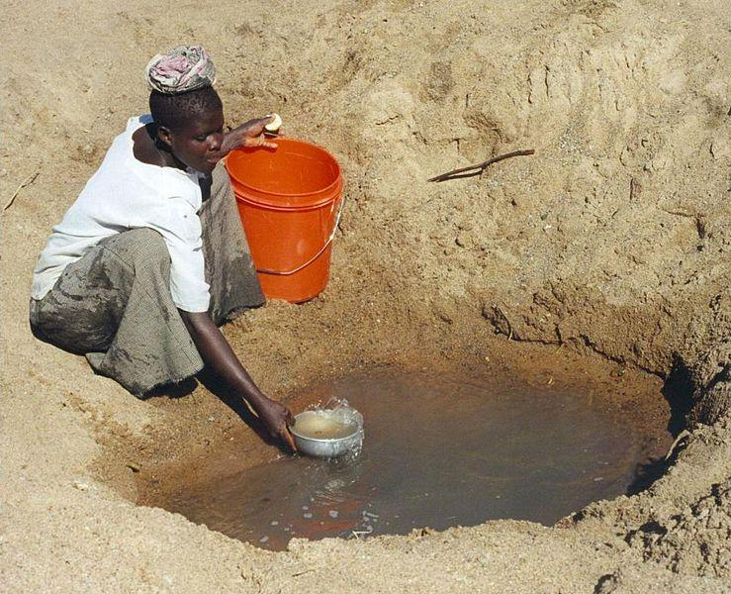

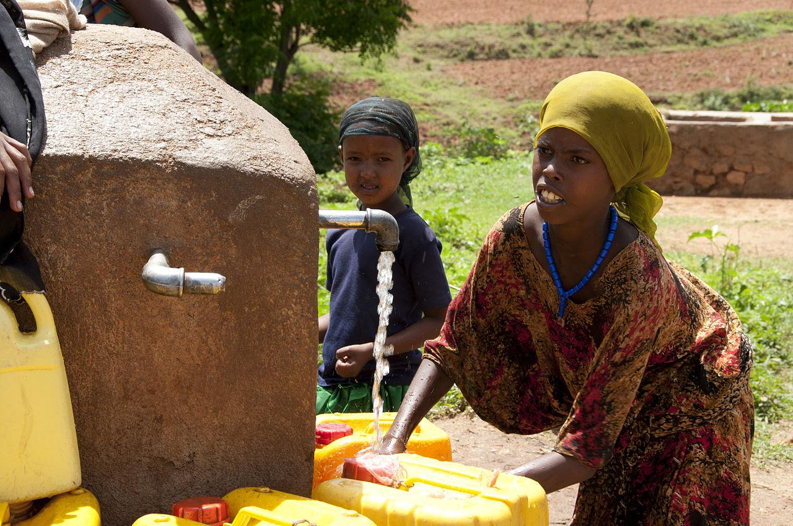
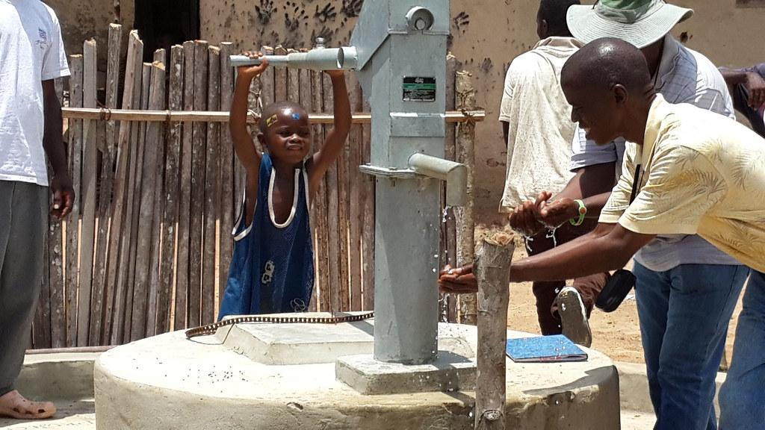
Introduction:
By : Prithvi Saravanakumar
Speaker : Prithvi
there could only be 6 words
Access to water is a big problem because if you don’t have it you just die
One billion people, almost 16% of Earth’s population have to walk for miles just to get water
Water is not shared equally, some have little some have a lots
So we must share water equally around the world
If you don’t share it equally, fresh water will be limited and everybody won’t have the water they need

Slide 3
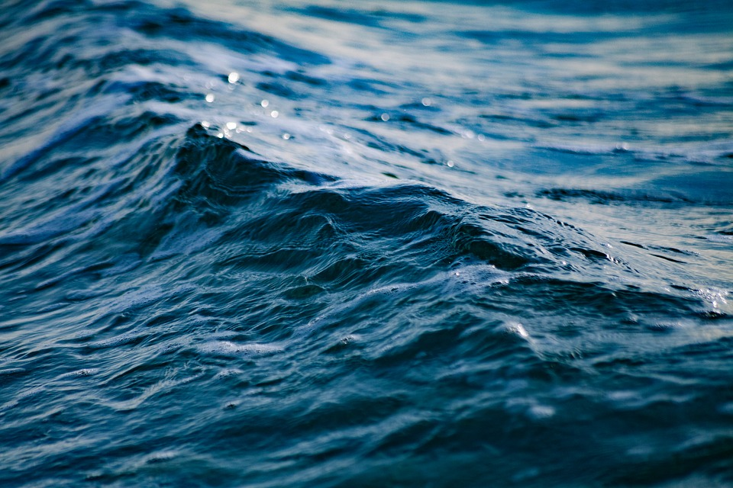
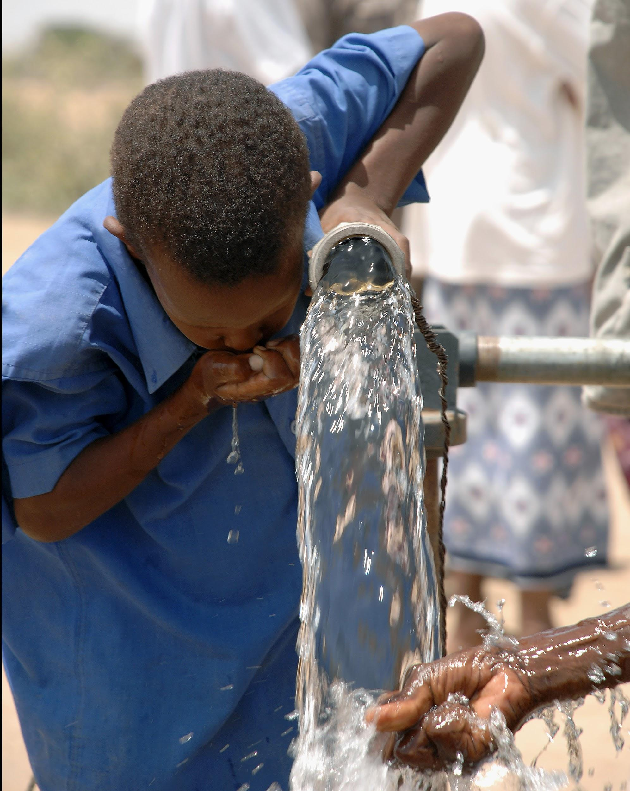
Deep dive in access to water
Help out everyone to save our water
Speaker : Aditi
People in Australia take 2 min showers.
Over 99% of earth's water is frozen
need water to cook and bath
Only 1% of water is accessible.
farmers won't grow crops without water
Water is not shared equally
Earth is known for water
People walk 15 min to get water

Slide 4
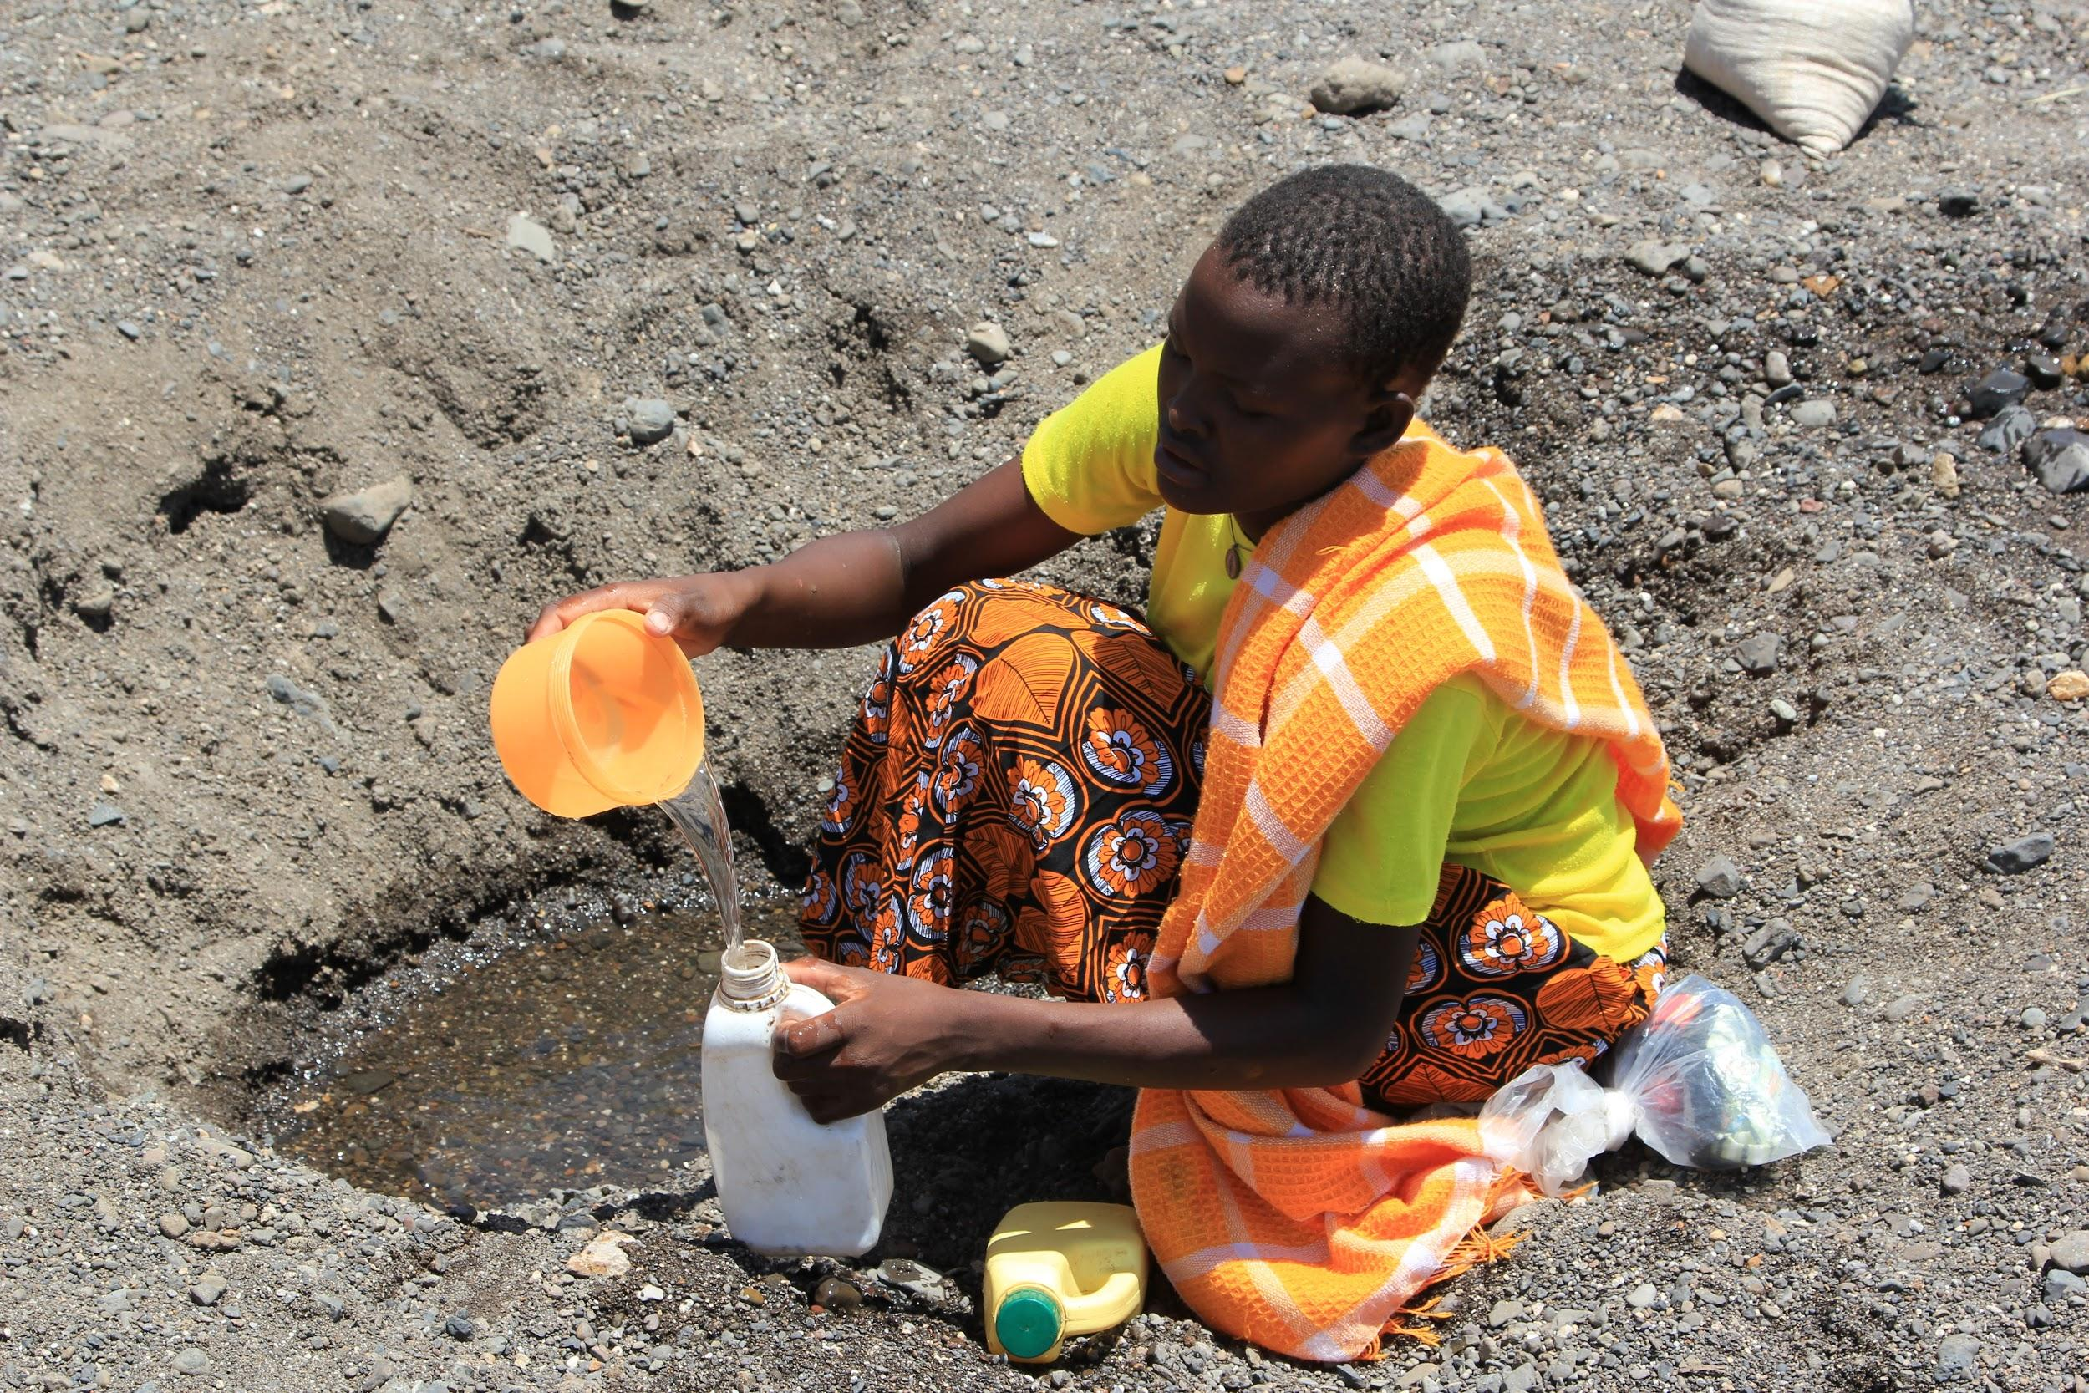
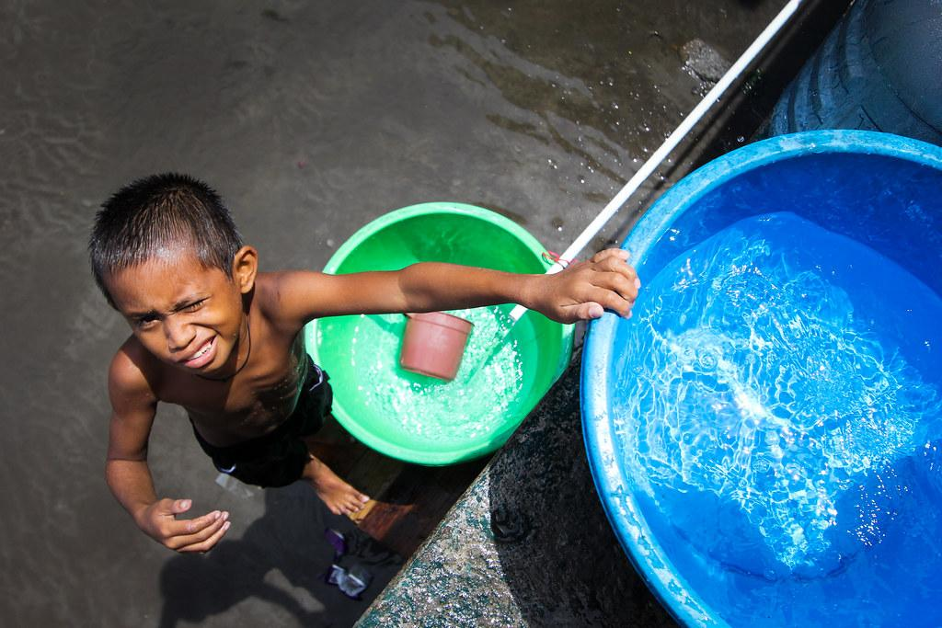
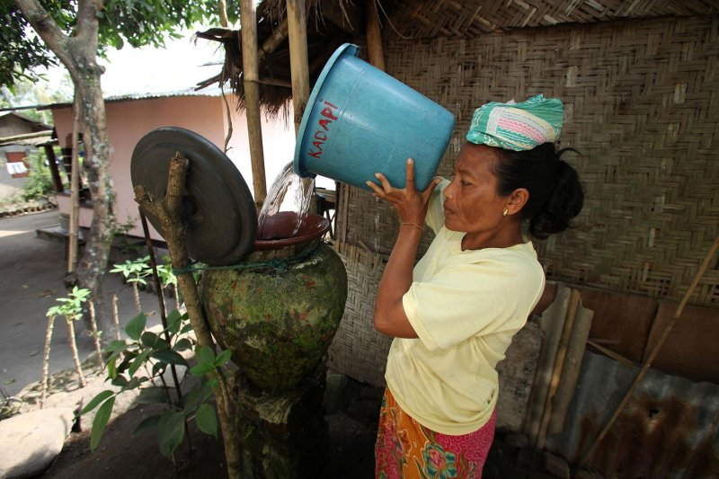
Facts about access to water
Speaker : Cecilia
need water to survive 300 million people in Africa do not have access to water
Some walk 15 minutes or more to get access to water
Amount of water not fairly distributed
China has access to 1/10 of fresh water
Now it is very easy to get water unlike then.

Slide 5

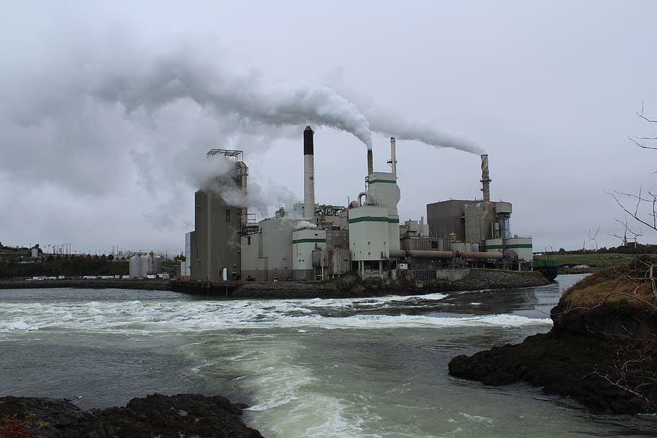
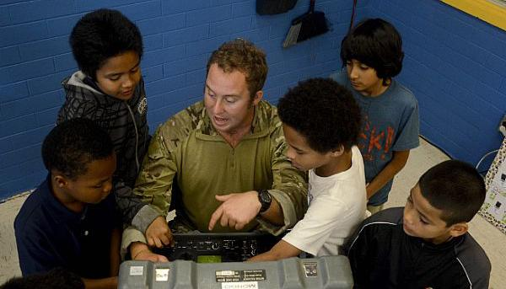

How can you help?
Speaker : Ryan
You can help by…
raise money for organizations,
sending water, like to pore
help teach and share info about the issue to build awareness.
support impactful organizations on the ground
pay particular attention to those most impacted.
recognize access to clean water isn't just an overseas problem.
you can build a well which has fresh water that people can drink
Notes:
You can help by…
raise money for organizations,
sending water, like to pore
help teach and share info about the issue to build awareness.
support impactful organizations on the ground
pay particular attention to those most impacted.
recognize access to clean water isn't just an overseas problem.
you can build a well which has fresh water that people can dri

Slide 6
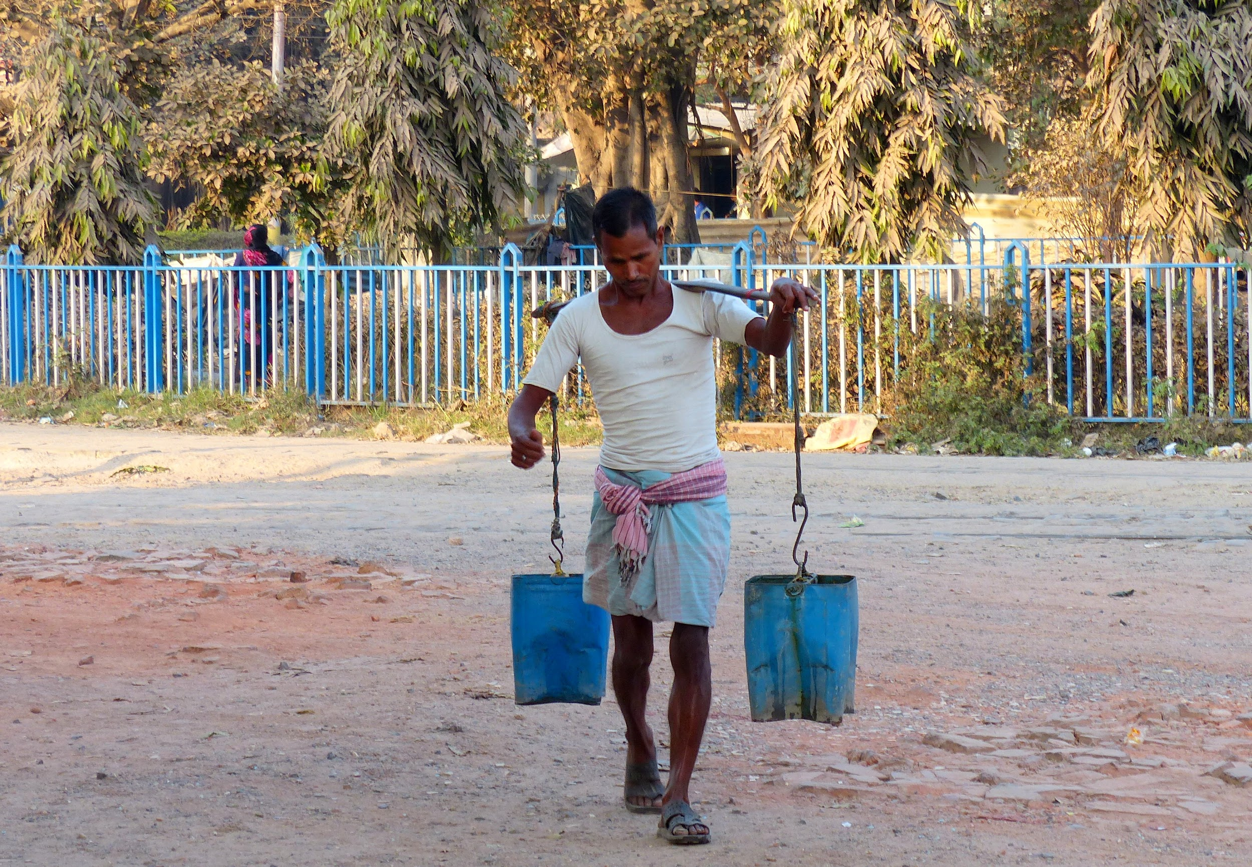
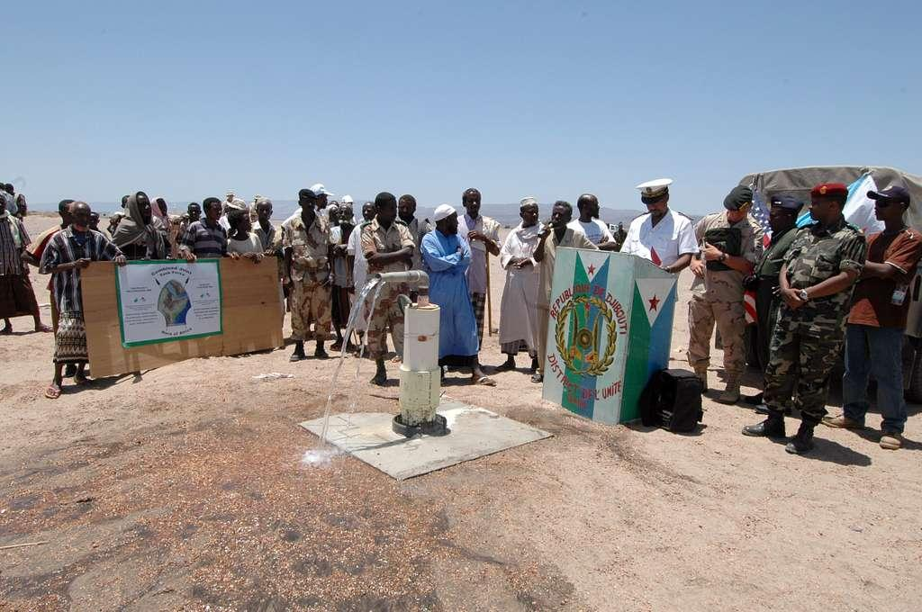
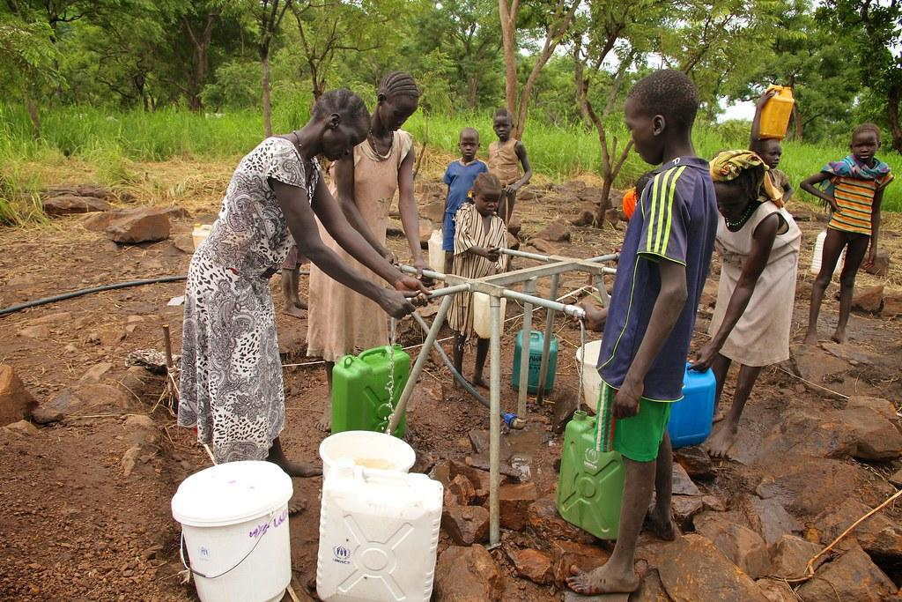

To conclude,
A big problem
Help by volunteering
Save our water resources
Uses of water
Ryan’s Well Foundation
Little freshwater available, rest in glaciers, we should not waste it
Conclusion
By Aarvi Khandelwal
Notes:
Access to water is a big problem and if we don’t act now people will get sick
You can help by volunteering and save our water resources.
You can also help by raising money for orgainisations
We use water for all sorts of things like for cooking , taking a bath , brushing our teeth and more.
Little freshwater is available and some of it is in glaciers, so we should use our water mindfully and do not waste it
If we try, we can get water to everyone who needs it.

Slide 7
Thank You!
Presented by : Prithvi, Aditi, Cecilia, Ryan and Aarvi

